Slide 1
GearVR Framework Tutorial
Scene Editor

Slide 2
Scene Editor
While developing a GearVRf app
Setup a scene using GVRTransform methods like:
Scene editor lets you drag and drop models in VR
public void setPositionX(float x)
public void setPositionY(float y)
public void setPositionZ(float z)
public void setScale(float x, float y, float z)
public void setRotationByAxis(float angle, float x, float y, float z)
public void rotateByAxis(float angle, float x, float y, float z)
public void rotateByAxisWithPivot(float angle, float axisX, float axisY,
float axisZ, float pivotX, float pivotY, float pivotZ)

Slide 3
App development workflow
Scene setup using Scene Editor
Copy 3D models from to /sdcard/SceneEditor
Load models from /sdcard/SceneEditor
Rotate, scale and move models in VR
Load a cubemap or spheremap for the environment
Auto export scene
Use scene in your GearVRf app
Import scene in your app
Refer to the GVRSceneObjects by name.

Slide 4
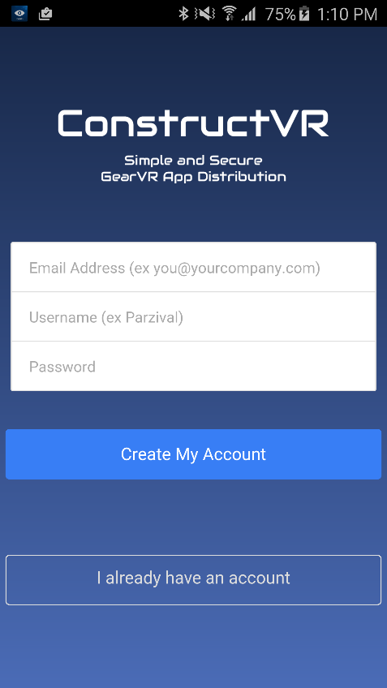
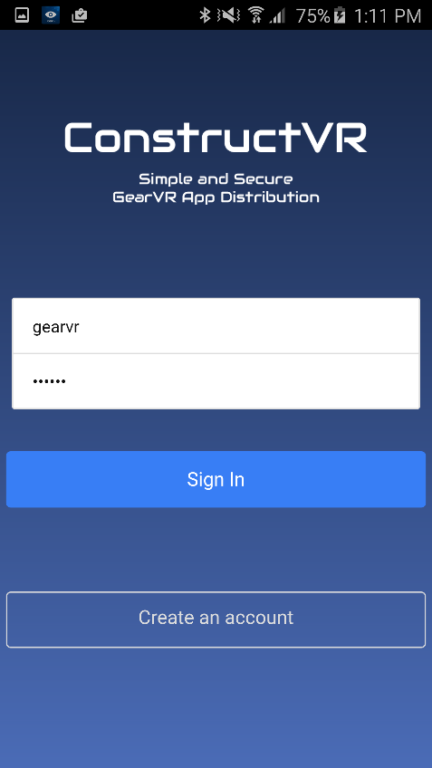
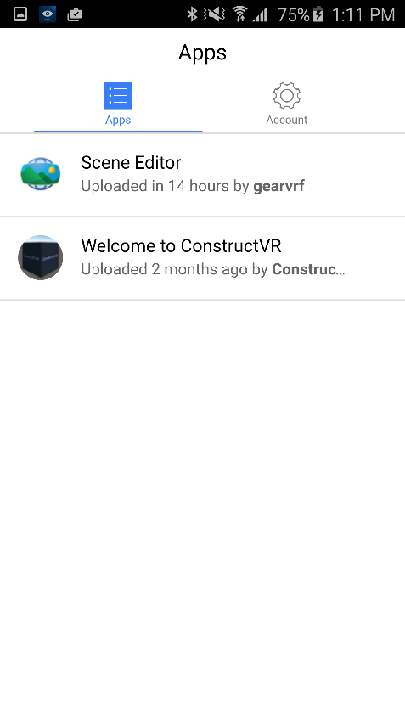
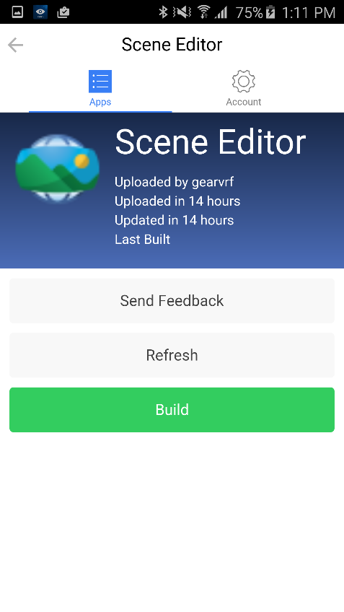
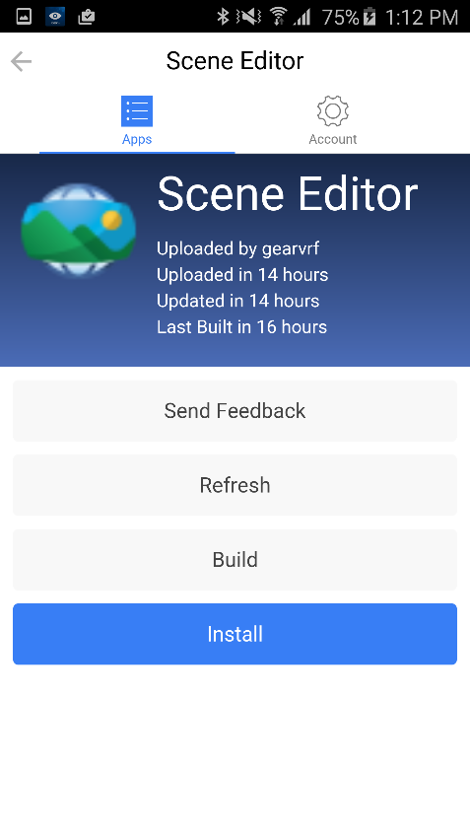
Scene Editor Installation
Download the ConstructVR app from the play store
https://play.google.com/store/apps/details?id=com.archonware.constructvr
password:gearvr

Slide 5
Scene Setup
Launch Scene Editor app
Copy assets to /sdcard/SceneEditor
Set up Scene

Slide 6
Import scene in your GVRf app
Import sceneserializer.aar as a new gradle module
\\corpdata_sj\MCL_HOME\parth.mehta\VRHackathon\LatestLibs
Add the following code:
SceneSerializer sceneSerializer = new SceneSerializer();
sceneSerializer.importScene(gvrContext, scene, new SceneLoaderListener() {
@Override
public void onEnvironmentLoaded(GVRSceneObject envSceneObject) {
}
@Override
public void onSceneObjectLoaded(GVRSceneObject sceneObject) {
if (sceneObject.getName().equals("gyrados-pokemon-go_1")) {
attachAnimation(sceneObject);
}
}
});

Slide 7
Thank You

